Slide 1
CLASSIFICATION OF PLANT
LEAF DISEASES USING CUSTOM WEIGHT INITIALIZATION BY SPARSE ENCODER
DARSHAN.G (171EC137)
DEEPAK.K (171EC162)

Slide 2
LIST OF MINI PROJECTS CARRIED OUT:
CLASSIFICATION OF DOG AND CAT USING MACHINE LEARNING
WILD PLANTS DETECTION USING DEEPLEARNING STUDIO
ENHANCING THE IMAGE RESOLUTION OF BLURRED IMAGES USING
DEEP LEARNING FOR SATELLITE SURVILLENCE
AUDITORIUM CONTROL SYSTEM
DIAMOND DETECTION
AIR POLLUTION MONITERING SYSTEM

Slide 3
PROPOSED SYSTEM
The dataset is collected from the repository.
The data is preprocessed and then fed into the convolution neural network
for training the convolution neural network that can be used as a classifier in
the later part.
The trained convolution neural network is used as a classifier to predict that the plant is
healthy or not. Then if it is not healthy, then the type of the affected disease.

Slide 4
VGG-16
VGG16 is a convolutional neural network model proposed by K. Simonyan and A. Zisserman from the University of Oxford in the paper “Very Deep Convolutional Networks for Large-Scale Image Recognition”.
The model achieves 92.7% top-5 test accuracy in ImageNet, which is a dataset of over 14 million images belonging to 1000 classes.
It was one of the famous model submitted to ILSVRC-2014.
It makes the improvement over AlexNet by replacing large kernel-sized filters (11 and 5 in the first and second convolutional layer, respectively) with multiple 3×3 kernel-sized filters one after another.
VGG16 was trained for weeks and was using NVIDIA Titan Black GPU’s.

Slide 5
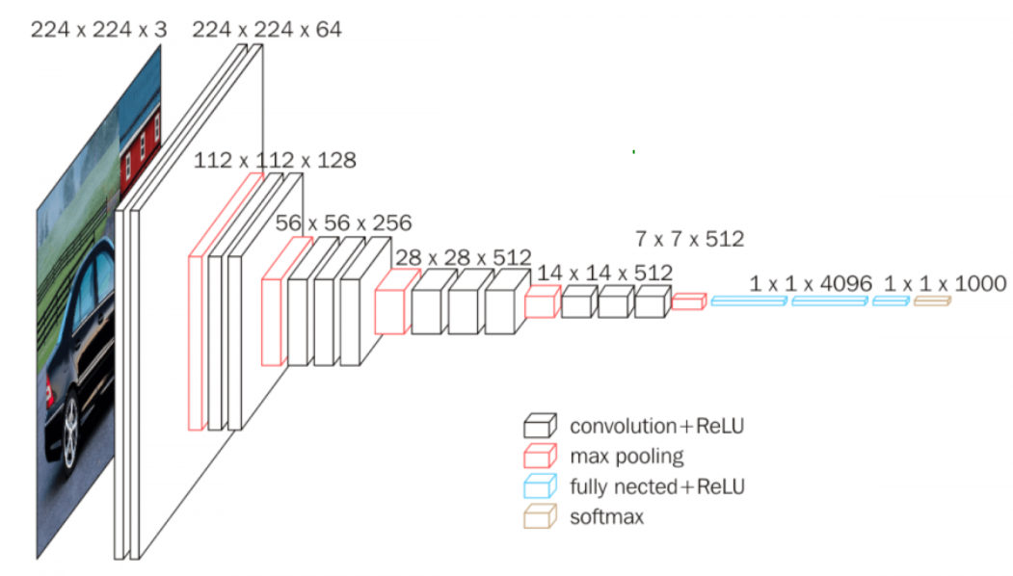
VGG-16 ARCHITECTURE

Slide 6
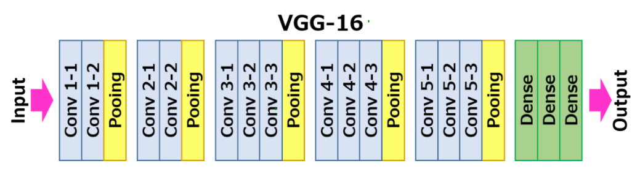
VGG-16 LAYOUT

Slide 7
VGG-16 DESCRIPTION
VGG-16 is a convolutional neural network architecture, it’s name VGG-16 comes from the fact that it has 16 layers.
It’s layers consists of Convolutional layers, Max Pooling layers, Activation layers, Fully connected layers.
There are 13 convolutional layers, 5 Max Pooling layers and 3 Dense layers which sums up to 21 layers but only 16 weight layers.
Conv 1 has number of filters as 64 while Conv 2 has 128 filters, Conv 3 has 256 filters while Conv 4 and Conv 5 has 512 filters.

Slide 8
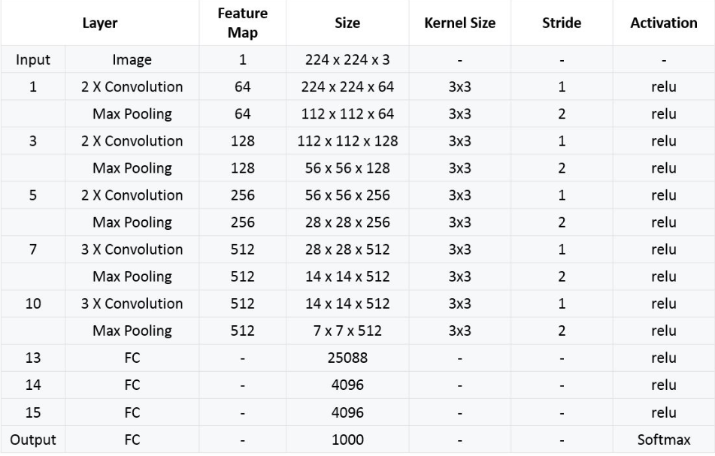
SUMMARY OF VGG-16 ARCHITECTURE

Slide 9
SPARSE ENCODING
Sparse coding is the study of algorithms which aim to learn a useful sparse representation of any given data. Each datum will then be encoded as a sparse code:
The algorithm only needs input data to learn the sparse representation. This is very useful since you can apply it directly to any kind of data, it is called unsupervised learning.
It will automatically find the representation without losing any information (As if one could automatically reveal the intrinsic atoms of one’s data).

Slide 10
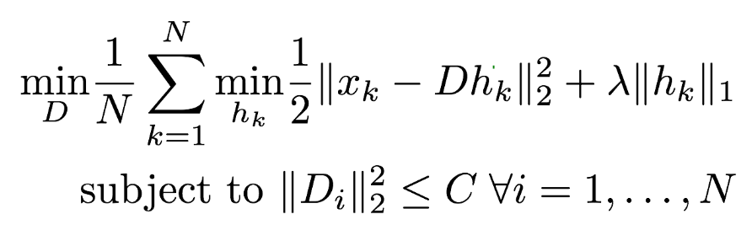
SPARSE ENCODING
where:
N is the number of datum in the data
x_k is the k given vector of the data
h_k is the sparse representation of x_k
D is the decoder matrix
lambda is the coefficient of sparsity
C is a given constant

Slide 11
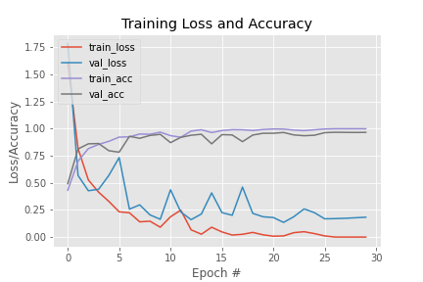
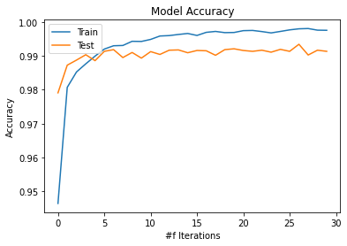
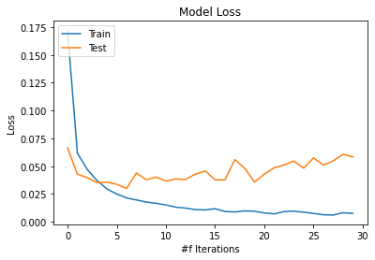
VGG-16 VS CUSTOM WEIGHT INITIALIZED VGG-16
VGG-16
CUSTOM WEIGHT INITIALIZED VGG-16

Slide 12
BLOCK DIAGRAM-VGG-16
INPUT IMAGE
VGG-16
MODEL
VGG-16 TRAINED
MODEL
DATASET
OUTPUT

Slide 13
BLOCK DIAGRAM-CUSTOM WEIGHT INITIALIZED VGG-16
INPUT IMAGE
CUSTOM WEIGHT INITIALIZED VGG-16
MODEL
TRAINED
MODEL
DATASET
OUTPUT

Slide 14
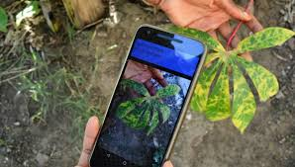
FUTURE WORK
The current work can be converted into a app which will help the farmers to find the disease easily by just taking a simple image on their phone and process it using the app.

Slide 15
CONCLUSION
The main theme of our project is the detection of plant diseases effectively
In our project we used VGG-16 which is one of the best model of modern days.
We have also used a custom weight initialized VGG-16 model.

Slide 16
LITERATURE SURVEY
A Literature Survey: Plant Leaf Diseases Detection Using Image Processing Techniques by K.Narsimha Reddy , B.Polaiah , N.Madhu.
Agricultural Plant Leaf Disease Detection Using Image Processing by Prof. Atul Shire , Prof. Umesh Jawarkar , Mr. Manoj Manmode.

Slide 17
REFERENCES
https://www.ipol.im/pub/art/2012/vgg16/article.pdf
https://github.com/ericmjonas/vgg16
https://en.Wikipedia.org/wiki/vgg16

